Slide 1
MLB Game Winner Predictor
UCSD Data Science Bootcamp Project 1, 01/11/2020
Alexis Perumal
Venkateswarlu Pinnika
Young You

Slide 2
Project Objective:
Build a predictive model that can predict the winner of an MLB game, before it starts.
Project Description/Outline:
Brainstorm the concept
Browse the dataset
Evaluate which factors drive runs
Build a simple 1 or 2 factor predictive model. Evaluate it.
Research Questions to Answer
What factors drive runs and game outcomes?
What is a reasonable expectation for predictive accuracy? Presumably 50% accurate is easy to do (random should do that).
Datasets used:
SeanLahman.com
-provides rich baseball game outcome for every MLB game going back to 1881.
-It includes game outcomes, player data, at bats, pitches.
-It is available as a CSV file

Slide 3
Objective: Read the dataset, do a simple prediction for games on a given date using data prior to that date, then and record some stats on how well it did.
1. Reads in the 2010 season as the baseline games dataset. It does some simple selection of columns and generates a few calculated fields.
2. It prompts the user to specify 'game day' which are the games it is to predict.
3. It calculates the avg net number of runs for the home team (when playing at home) and the avg net number of runs for the visiting team (when playing away).
4. For a given game, the predicted winner is the team with the greatest avg net runs home or away (as applicable).
5. The prediction is compared with the actual results that day, with % correct reported.

Slide 4
Proposed next steps 2:
1. Integrate Venkat's "concat" capability to combine datasets across year blocks to result
in a much larger dataset. Note that for development we may want to keep the dataset
smaller size so that it doesn't take a long time to run.
2. Move this out of jupyter notebook into standard Python and embed the prediction logic
into a function that can be called repeatedly with different dates.
3. Run trials with large numbers of dates to product large numbers of predictions and results.
4. Write results to a file. Possibly generate some plot of results as a function of
training set window size.
5. Start experimenting with differnt prediction functions, initially across individual
factors, and then with multiple factors.
6. Consider a statistically meaningful regresssion analysis to select factors and training
set window size, by factor.
7. If someone has energy, consider using a web API to hit a website with current day
game schedule so we can predict games more recent than the dataset.

Slide 5
Venkat : Modified the code and included the below changes
1. Included the logic to combine all data files into one data frame
2. Included cleanup logic to clean missing data rows if any such rows exists
Alexis: Extend from "hello-world" to a useful predictor harness.
Implement a window to constrain the lookback period to n gamedays.
Venkat: Building the new prediction algorithm.
Calculate Avg Net runs only for head-head teams, and see if it improves the forecst accuracy

Slide 6
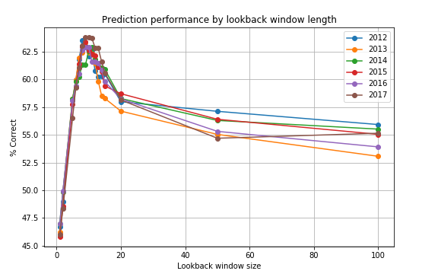
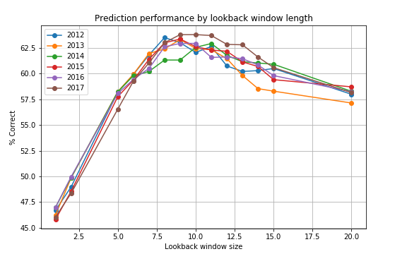
Prediction Performance by Lookback Window Length
Conclusion

